Slide 1
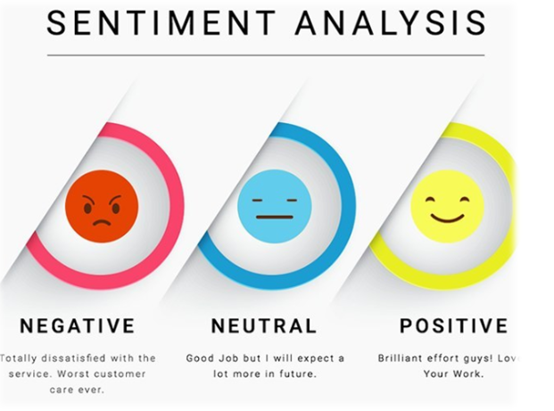
SENTIMENT ANALYSIS For Movie Reviews
DONE BY:
ABHISHEK SRIRAM

Slide 2
Contents
1
5
Project Overview
Model Evaluation
2
6
Testing on New Data
About Dataset
3
Text Preprocessing
4
Model Building

Slide 3
1 - Project Overview
This project aims to analyze movie reviews and classify them as either positive or negative using Natural Language Processing (NLP) techniques. Leveraging machine learning algorithms, it offers an efficient method for sentiment analysis. The dataset consists of labeled movie reviews from IMDB, and multiple classifiers are trained to identify the best-performing model, which is then saved for future sentiment predictions.

Slide 4
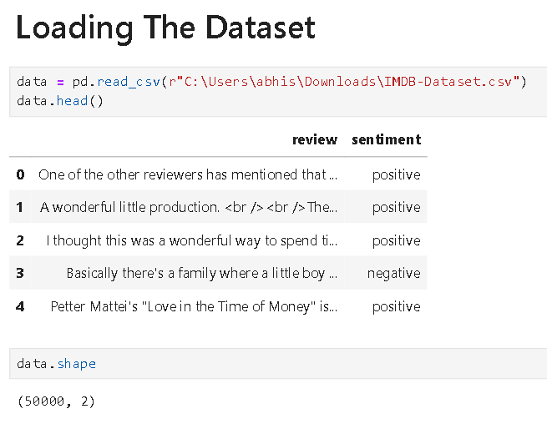
2 - About Dataset
The project utilizes the IMDB Dataset, comprising 50,000 movie reviews, each labeled with either a positive or negative sentiment.

Slide 5
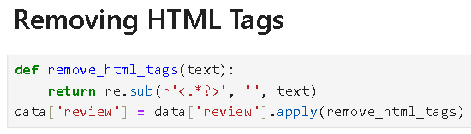
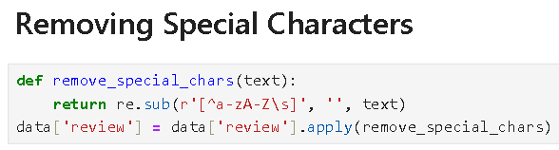
3 - Text Preprocessing

Slide 6
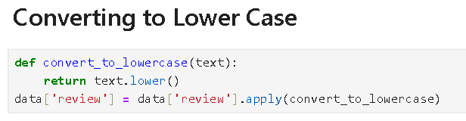
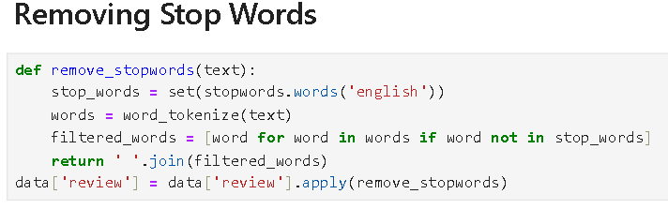

Slide 7
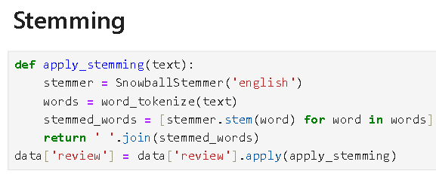
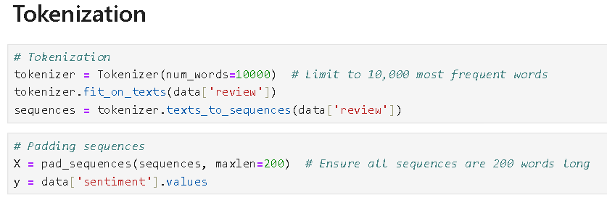

Slide 8
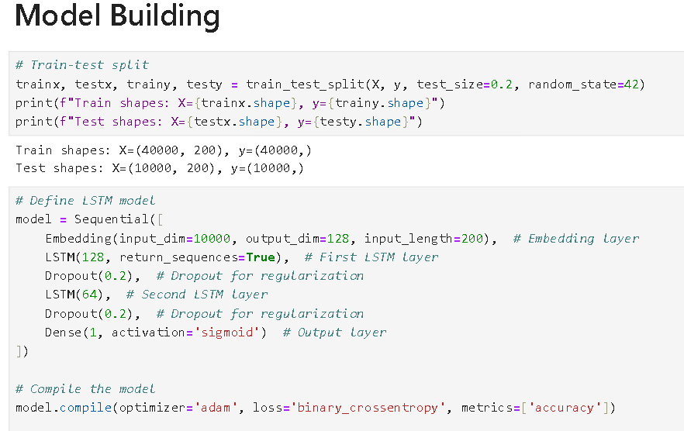
4 - Model Building

Slide 9
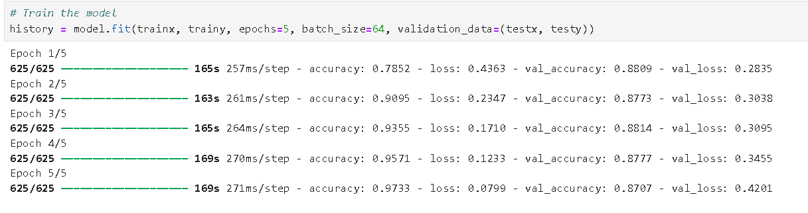

Slide 10
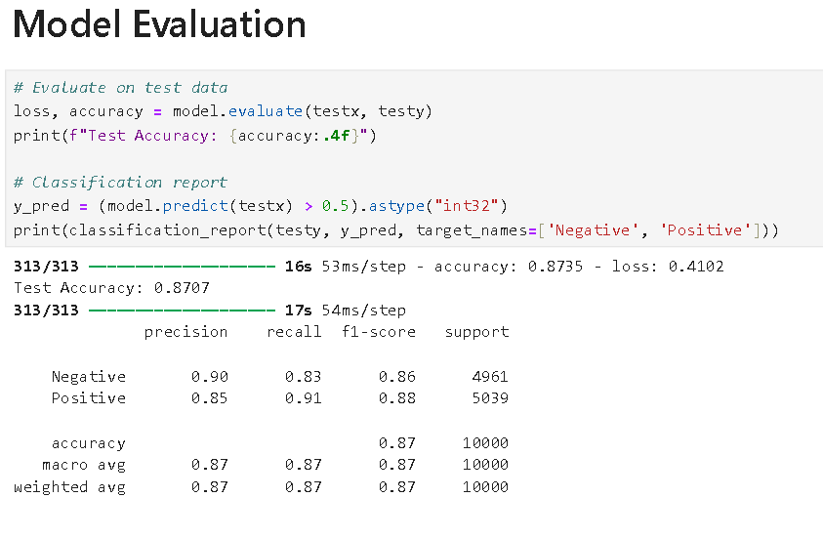
5 - Model Evaluation

Slide 11
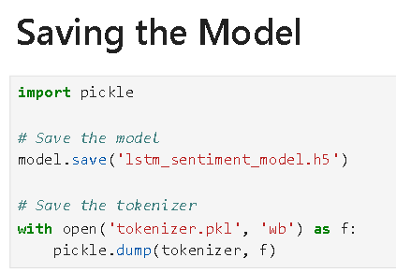

Slide 12
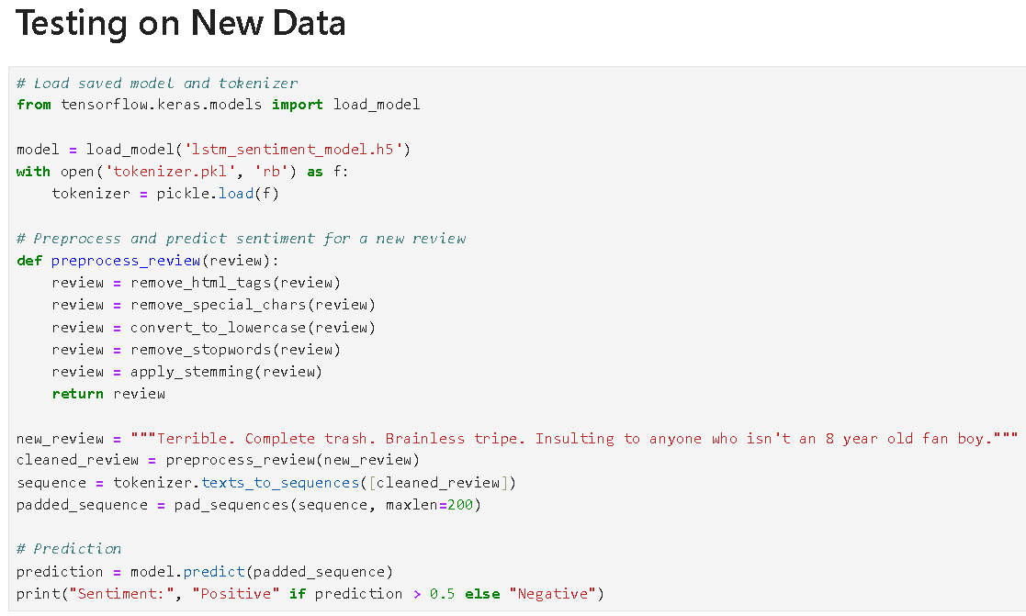

6 - Testing on New Data

Slide 13
Thank You

